Slide 1
CUDA Programming

Slide 2
Acknowledgments
●
Most of the content of this presentation is from Mark Harris (Nvidia Corporation), “CUDA C/C++ BASICS”
– http://developer.download.nvidia.com/compute/developertrai ningmaterials/presentations/cuda_language/Introduction_to_ CUDA_C.pptx
Salvatore Orlando (Univ. Ca' Foscari di Venezia) Tim Mattson (Intel Labs)
●
●
“Hands-on Intro to CUDA for OpenCL programmers”
CUDA C programming guide
http://docs.nvidia.com/cuda/cuda-c-programming-guide/
●

Slide 3
Introduction
Because of the high potential of data parallelism in graphics applications, the design of GPU architectures relied on specialized processor cores
In addition to graphics processing, GPUs can also be employed for general non-graphics applications
●
Manycore GPUs (Graphics Processing Units) are available in almost all current hardware platforms
Originally, these processors have been designed for graphics applications
●
–
●
If data parallelism is large enough to fully utilize the high number of compute cores in a GPU
The trend to use GPUs for general numerical applications has inspired GPU manufacturers, such as NVIDIA, to develop the programming environment CUDA and OpenCL
–
●

Slide 4
CUDA
CUDA = Compute Unified Device Architecture Exposes a data-parallel programming model CUDA vs OpenCL
– OpenCL is a portable and open alternative for programming GPUs, CPUs and other architectures
●
●
●
OpenCL is based on standard C/C++ plus libraries
No vendor lock-in
–
However, OpenCL is being adopted slowly
Some implementations not as efficient as CUDA (up to 30% slower) Some implementations are buggy
OpenCL programs are much more verbose than CUDA ones
●
●
–
Eventually the problems above will be solved

Slide 5
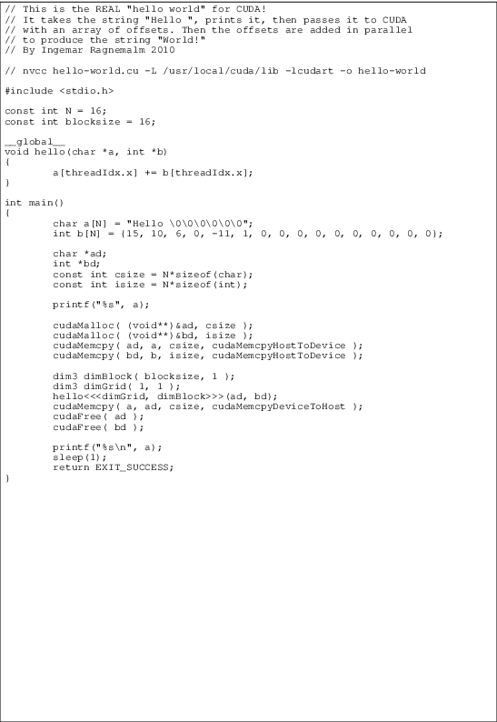
Hello, world: CUDA

Slide 6
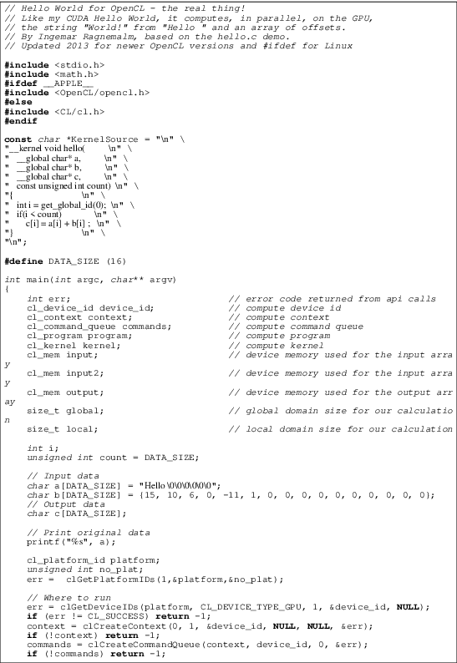
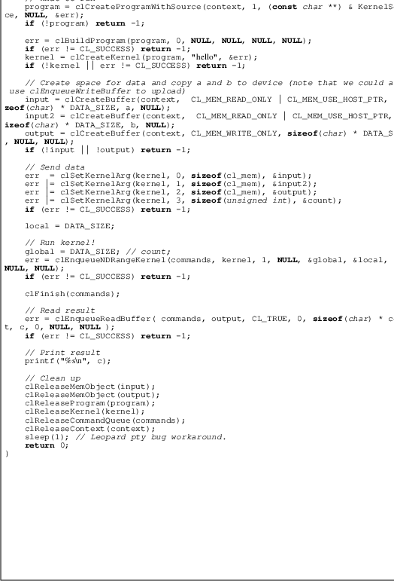
Hello, world: OpenCL
CUDA Pr
ogramming

Slide 7
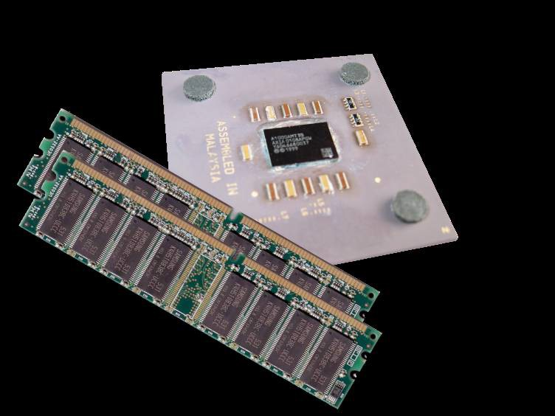
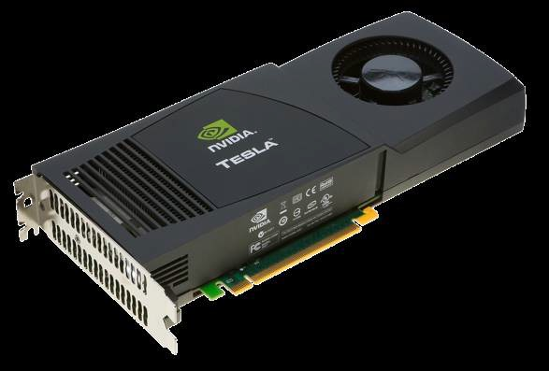
Terminology
●
Host
Host
Device
The CPU and its memory (host memory)
Device
–
●
– The GPU and its memory (device memory)
Host Memory
GPU
Device Memory
CPU
PCIe Bus
CUDA Programming
8
© NVIDIA corp.

Slide 8
Basic concepts
●
CUDA separate a program into
– a CPU program (the host program), which includes all I/O operations or operation for user interaction, and
a GPU program (the device program), which contains all computations to be executed on the GPU.
–
●
The simplest case of interaction between host program and device program is implemented by
– a host program that first copies data into the global memory of the GPU
the same host program calls device functions to initiate the processing on the GPU
–
CUDA Programming
9

Slide 9
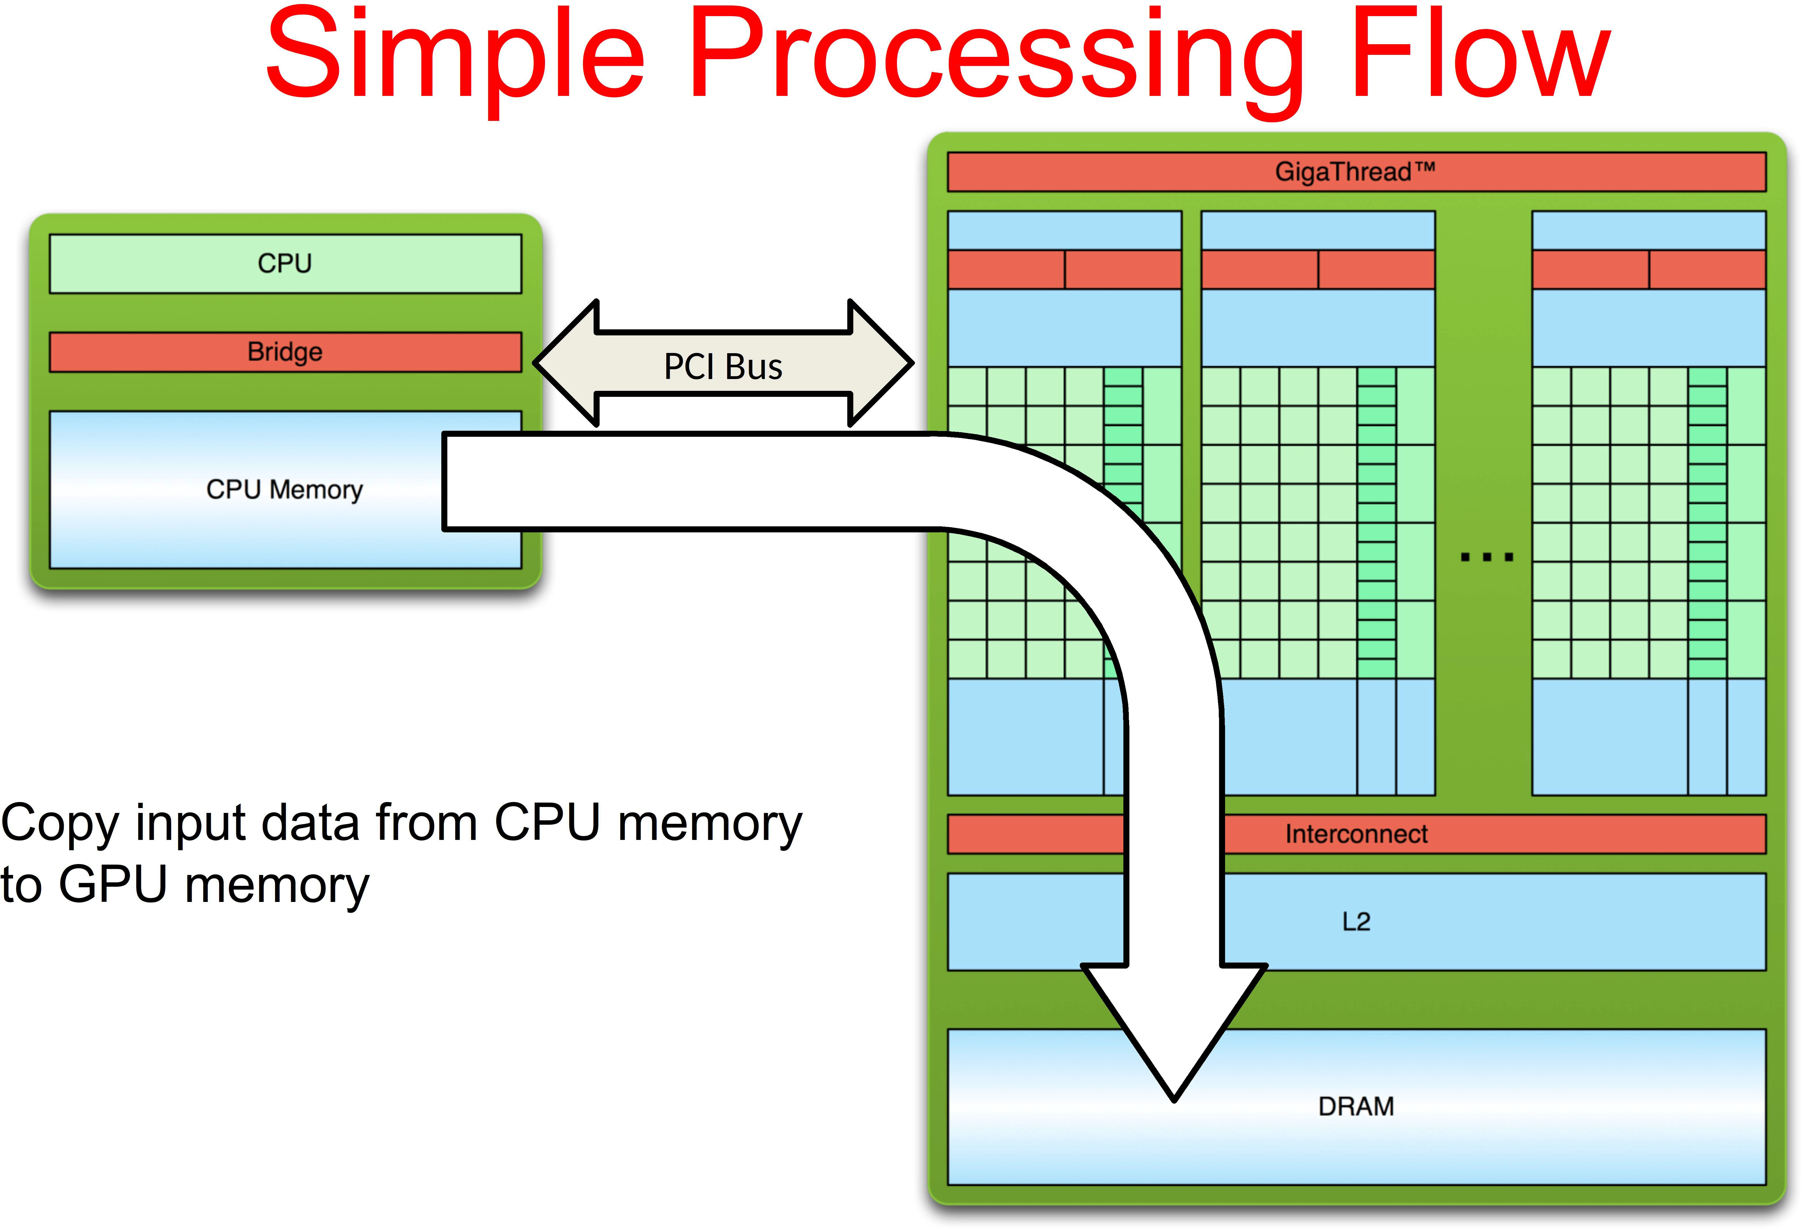
1.
9
© NVIDIA corp.

Slide 10
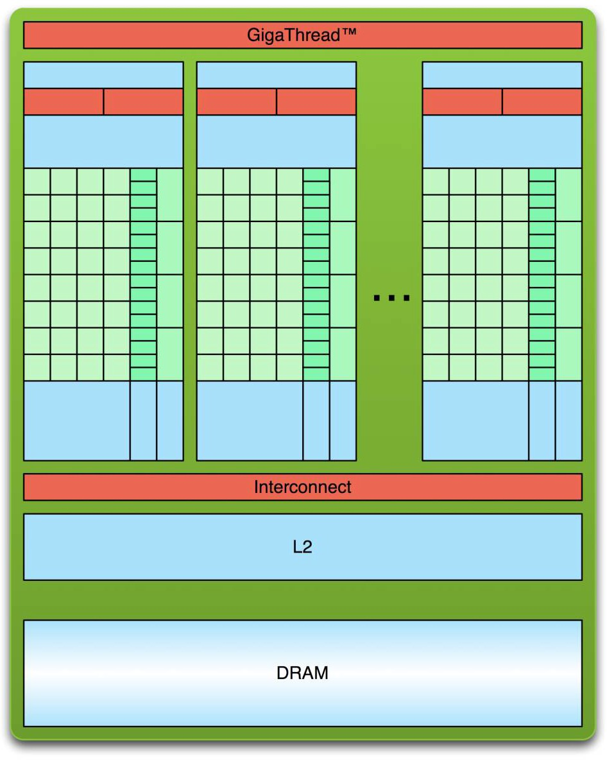
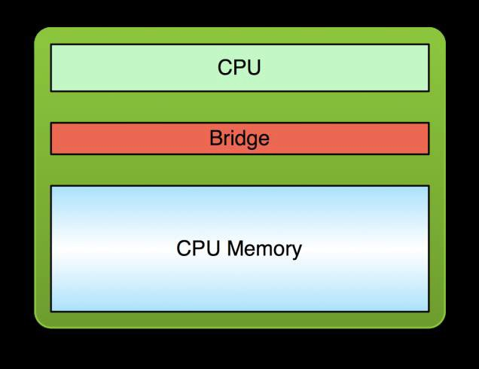
Simple Processing Flow
PCI Bus
Copy input data from CPU memory to GPU memory
Load GPU program and execute, caching data on chip for performance
10
© NVIDIA corp.

Slide 11
Simple Processing Flow
PCI Bus
Copy input data from CPU memory to GPU memory
Load GPU program and execute, caching data on chip for performance
Copy results from GPU memory to CPU memory
11
© NVIDIA corp.

Slide 12
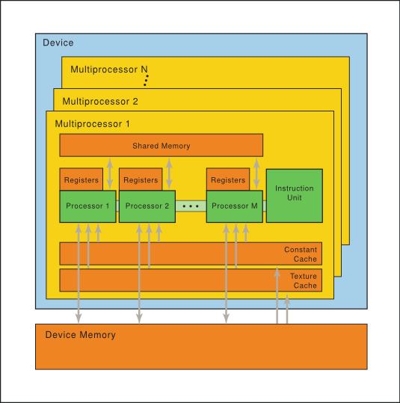
Terminology
●
A GPU comprises several multi- threaded SIMD processors
SIMD processor = Streaming Multiprocessors (SMs) composed of many Streaming Processors (SPs)
Each SIMD processors has several functional units (cores) that can execute the same SIMD instruction on different data
The actual number of SIMD processors depends on the GPU model
–
●
●
– For example, the NVIDIA GTX480 GPU has up to 15 SMs
http://docs.nvidia.com/cuda/parallel-thread-execution/
CUDA Programming
13

Slide 13
Terminology
A THREAD is the minimal unit of work.
Grid
●
Block 0,0
Block 1,0
Block 2,0
Block 0,0
– All the threads execute the same KERNEL function
Threads are grouped in WARPs of 32 for scheduling, i.e. WARPs are the minimal units of scheduling
–
Block 0,1
Block 1,1
Block 2,1
Block 0,0
●
A BLOCK is an independent subpiece of work that can be executed in any order by a SM
–
–
A 3D array of threads
Max no. of threads in a block: 512 threads (up to Version 2) and 1024 threads (since Version 3).
Block 1,1
Thread 0,0 Thread 1,0 Thread 2,0 Thread 3,0 Thread 4,0
Thread 0,1 Thread 1,1 Thread 2,1 Thread 3,1 Thread 4,1
Thread 0,2 Thread 1,2 Thread 2,2 Thread 3,2 Thread 4,2
●
A GRID is a piece of work that can be executed by the GPU
– A 2D array of BLOCKs (3D since CUDA Version 3)
CUDA Programmin
g
14

Slide 14
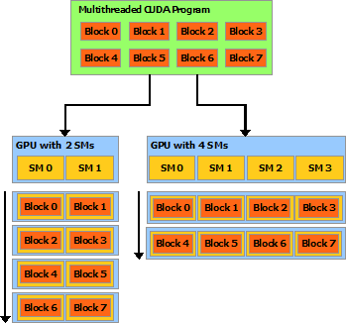
Automatic scalability
●
Do we need to take care of the device computing power (number of SM) ?
– No, because the block scheduler can re-arrange blocks accordingly
A Grid contains a set of independent blocks, which can be executed in any order
–
http://docs.nvidia.com/cuda/cuda-c-programming-guide/

Slide 15
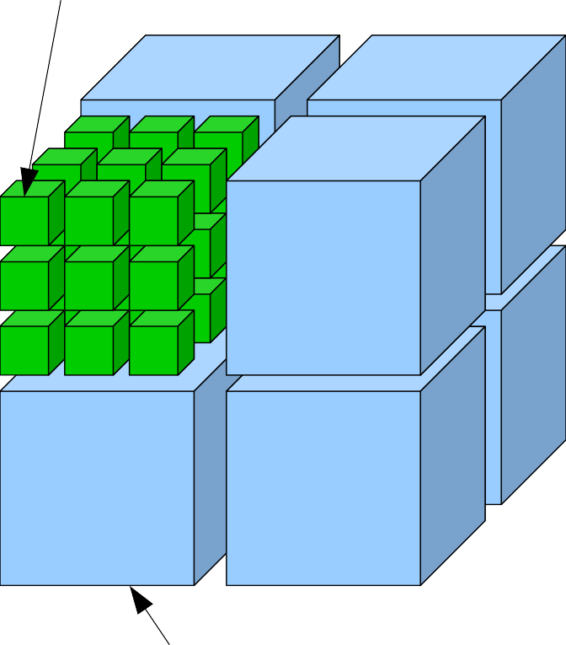
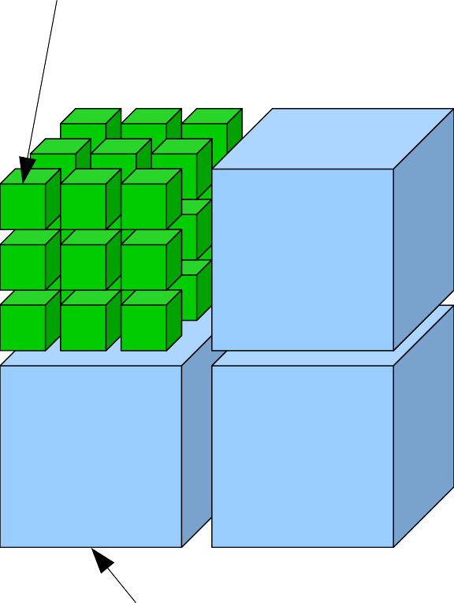
Summary
ThreadIdx.{x,y,z}
ThreadIdx.{x,y,z}
z
x
y
blockIdx.{x,y,z}
blockIdx.{x,y}
Compute Capability ≥ 2.x
Compute Capability < 2.x

Slide 16
CUDA thread scheduling
●
A CUDA warp is a group of 32 CUDA threads that execute simultaneously
–
–
Identifiable uniquely by dividing the Thread Index by 32
The hardware is most efficiently utilized when all threads in a warp execute instructions from the same program address
If threads in a warp diverge, then some execution pipelines go unused
If threads in a warp access aligned, contiguous blocks of DRAM, the accesses are coalesced into a single high- bandwidth access
–
–
●
A CUDA warp represents the minimum granularity of efficient SIMD execution

Slide 17
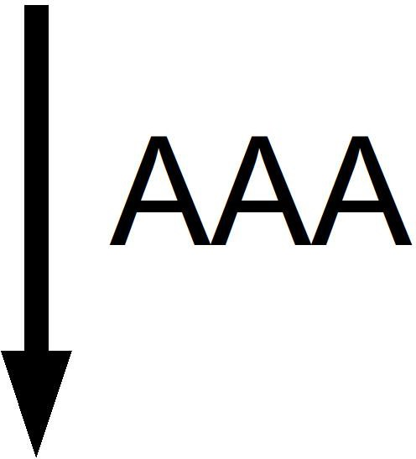

Single Instruction Multiple Data
●
Individual threads of a warp start together at the same program address
Each thread has its own program counter and register state
Warp
int x;
AAA
if (x > 0) {
XXX
} else {
YYY
}
BBB
●
XXX
– Each thread is free to branch and execute independently
Provides the MIMD abstraction branch behavior
–
●
Each branch will be executed serially
– Threads not following the current branch will be disabled

Slide 18
Hands-on introduction to CUDA programming

Slide 19
Hello World!
Standard C that runs on the host
The NVIDIA compiler (nvcc) can be used to compile programs, even with no device code
●
●
/* cuda-hello0.cu */ #include <stdio.h> int main(void)
{
printf("Hello World!\n");
return 0;
}
$ nvcc hello_world.cu
$ ./a.out Hello World!
© NVIDIA corp.

Slide 20
Hello World! with Device Code
/* cuda-hello1.cu */
#include <stdio.h>
global void mykernel(void) { }
int main(void)
{
mykernel<<<1,1>>>( ); printf("Hello World!\n"); return 0;
}
Two new syntactic elements
© NVIDIA corp.

Slide 21
Hello World! with Device Code
global void mykernel(void) { }
●
CUDA/C keyword global indicates a function that:
–
–
Runs on the device
Is called from host code
– global functions must return void
●
nvcc separates source code into host and device components
– Device functions (e.g., mykernel()) are processed by the NVIDIA compiler
Host functions (e.g., main()) are processed by the standard host compiler (e.g., gcc)
–
© NVIDIA corp.

Slide 22
Hello World! with Device Code
mykernel<<<1,1>>>( );
●
Triple angle brackets mark a call from host code to device code
–
–
Also called a “kernel launch”
We’ll return to the parameters (1,1) in a moment
●
That’s all that is required to execute a function on the GPU!
© NVIDIA corp.

Slide 23
Hello World! with Device Code
global void mykernel(void)
{ }
int main(void) { mykernel<<<1,1>>>( ); printf("Hello World!\n"); return 0;
}
$ nvcc cuda-hello1.cu
$ ./a.out Hello World!
●
mykernel() does nothing
© NVIDIA corp.

Slide 24
Parallel Programming in CUDA/C
●
But wait… GPU computing is about massive parallelism!
We need a more interesting example…
We’ll start by adding two integers and build up to vector addition
●
●
a
a[ ]
+
+
b
b[ ]
=
=
c
c[ ]
© NVIDIA corp.

Slide 25
Addition on the Device
●
A simple kernel to add two integers
global void add(int *a, int *b, int *c)
{
*c = *a + *b;
}
●
As before global is a CUDA C/C++ keyword meaning
– add() will execute on the device
add() will be called from the host
–
© NVIDIA corp.

Slide 26
Addition on the Device
●
Note the use of pointers for the variables
global void add(int *a, int *b, int *c)
{
*c = *a + *b;
}
●
add() runs on the device, so a, b and c must point to device memory
We need to allocate memory on the GPU
●
© NVIDIA corp.

Slide 27
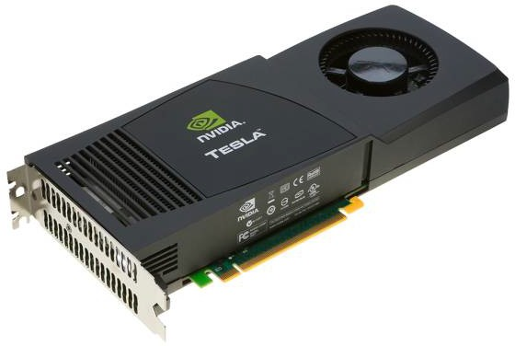
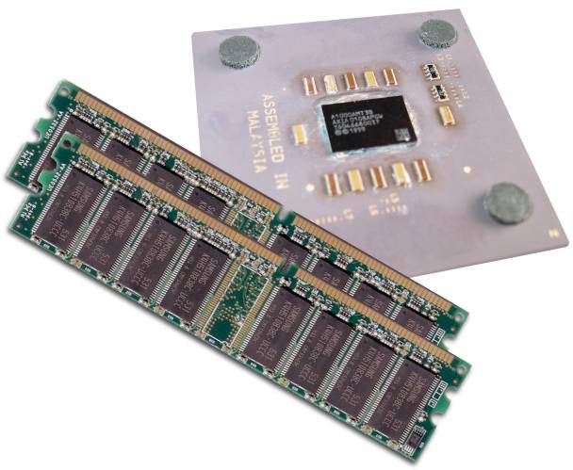
Memory Management
Host and device memory are separate entities
– Device pointers point to GPU memory
●
May be passed to/from host code
May not be dereferenced in host code
–
Host pointers point to CPU memory
May be passed to/from device code
May not be dereferenced in device code
●
Simple CUDA API for handling device memory
– cudaMalloc(), cudaFree(), cudaMemcpy()
Similar to the C equivalents malloc(), free(), memcpy()
–
© NVIDIA corp.

Slide 28
Addition on the Device: main()
/* cuda-vecadd0.cu */
int main(void) {
int a, b, c;
int *d_a, *d_b, *d_c;
/* host copies of a, b, c */
/* device copies of a, b, c */
const size_t size = sizeof(int);
/* Allocate space for device copies of a, b, c */ cudaMalloc((void **)&d_a, size); cudaMalloc((void **)&d_b, size); cudaMalloc((void **)&d_c, size);
/* Setup input values */
a = 2; b = 7;
/* Copy inputs to device */
cudaMemcpy(d_a, &a, size, cudaMemcpyHostToDevice); cudaMemcpy(d_b, &b, size, cudaMemcpyHostToDevice);
/* Launch add() kernel on GPU */
add<<<1,1>>>(d_a, d_b, d_c);
/* Copy result back to host */
cudaMemcpy(&c, d_c, size, cudaMemcpyDeviceToHost);
/* Cleanup */
cudaFree(d_a); cudaFree(d_b); cudaFree(d_c); return 0;
}
CUDA Programming
© NVIDIA corp.

Slide 29
Coordinating Host & Device
Kernel launches are asynchronous
– Control returns to the CPU immediately
CPU needs to synchronize before consuming the results
●
●
cudaMemcpy() | Blocks the CPU until the copy is complete Copy begins when all preceding CUDA calls have completed
cudaMemcpyAsync() | Asynchronous, does not block the CPU
cudaDeviceSynchronize() | Blocks the CPU until all preceding CUDA calls have completed
© NVIDIA corp.

Slide 30
Running in parallel
© NVIDIA corp.

Slide 31
Moving to Parallel
GPU computing is about massive parallelism
– So how do we run code in parallel on the device?
add<<< 1, 1 >>>();
●
add<<< N, 1 >>>();
# of blocks # of threads per block
Instead of executing add() once, execute N times in parallel
●
© NVIDIA corp.

Slide 32
Vector Addition on the Device
With add() running in parallel we can do vector addition
Terminology: each parallel invocation of add() is referred to as a block
●
●
–
–
The set of blocks is referred to as a grid
Each invocation can refer to its block index using blockIdx.x
global void add(int *a, int *b, int *c)
{
c[blockIdx.x] = a[blockIdx.x] + b[blockIdx.x];
}
●
By using blockIdx.x to index into the array, each block handles a different index
© NVIDIA corp.

Slide 33
Vector Addition on the Device
●
On the device, each block can execute in parallel
global void add(int *a, int *b, int *c)
{
c[blockIdx.x] = a[blockIdx.x] + b[blockIdx.x];
}
blockIdx.x = 0
blockIdx.x = 1
blockIdx.x = 2
blockIdx.x = 3
CUDA
block
Block 0
Block 1
Block 02
Block 3
a[0]
+ b[0]
=
c[0]
a[1]
+ b[1]
=
c[1]
a[2]
+ b[2]
=
c[2]
a[3]
+ b[3]
=
c[3]
CUDA
thread
Thr 0
Thr 0
Thr 0
Thr 0
© NVIDIA corp.

Slide 34
/* cuda-vecadd1.cu */ #define N 1024 int main(void) {
int *a, *b, *c;
int *d_a, *d_b, *d_c;
/* host copies of a, b, c */
/* device copies of a, b, c */
const size_t size = N * sizeof(int);
/* Alloc space for device copies of a, b, c */ cudaMalloc((void **)&d_a, size); cudaMalloc((void **)&d_b, size); cudaMalloc((void **)&d_c, size);
/* Alloc space for host copies of a,b,c and setup input values */
a = (int *)malloc(size); vec_init(a, N); b = (int *)malloc(size); vec_init(b, N); c = (int *)malloc(size);
/* Copy inputs to device */
cudaMemcpy(d_a, a, size, cudaMemcpyHostToDevice); cudaMemcpy(d_b, b, size, cudaMemcpyHostToDevice);
/* Launch add() kernel on GPU with N blocks */
add<<<N,1>>>(d_a, d_b, d_c);
/* Copy result back to host */
cudaMemcpy(c, d_c, size, cudaMemcpyDeviceToHost);
/* Cleanup */
free(a); free(b); free(c);
cudaFree(d_a); cudaFree(d_b); cudaFree(d_c);
return 0;
}
© NVIDIA corp.
CUDA Programming 35

Slide 35
Review
Difference between host and device
– Host ↔ CPU, device ↔ GPU
●
●
Using global to declare a function as device code
–
–
Executes on the device Called from the host
Passing parameters from host code to a device function Basic device memory management
●
●
–
–
–
cudaMalloc() cudaMemcpy() cudaFree()
●
Launching parallel kernels
– Launch N copies of add() with add<<<N,1>>>(…);
Use blockIdx.x to access block index
–
36
© NVIDIA corp.

Slide 36
Introducing threads
CUDA Programming
37

Slide 37
CUDA Threads
Terminology: a block can be split into parallel threads Let’s change add() to use parallel threads instead of parallel blocks
●
●
global void add(int *a, int *b, int *c)
{
c[threadIdx.x] = a[threadIdx.x] + b[threadIdx.x];
}
We use threadIdx.x instead of blockIdx.x
Need to make one change in main()…
●
●
© NVIDIA corp.

Slide 38
CUDA Threads
global void add(int *a, int *b, int *c)
{
c[threadIdx.x] = a[threadIdx.x] + b[threadIdx.x];
}
blockIdx.x = 0
Block 0
a[0]
+ b[0]
= c[0]
a[1]
+ b[1]
= c[1]
a[2]
+ b[2]
= c[2]
a[3]
+ b[3]
= c[3]
a[4]
+ b[4]
= c[5]
a[5]
+ b[5]
= c[5]
a[6]
+ b[6]
= c[6]
a[7]
+ b[7]
= c[7]
threadIdx.x=0
threadIdx.x=1
threadIdx.x=2
threadIdx.x=3
threadIdx.x=4
threadIdx.x=5
threadIdx.x=6
threadIdx.x=7
© NVIDIA corp.

Slide 39
/* cuda-vecadd2.cu */ #define N 1024 int main(void) {
int *a, *b, *c;
int *d_a, *d_b, *d_c;
/* host copies of a, b, c */
/* device copies of a, b, c */
const size_t size = N * sizeof(int);
/* Alloc space for device copies of a, b, c */ cudaMalloc((void **)&d_a, size); cudaMalloc((void **)&d_b, size); cudaMalloc((void **)&d_c, size);
/* Alloc space for host copies of a,b,c and setup input values */
a = (int *)malloc(size); random_ints(a, N); b = (int *)malloc(size); random_ints(b, N); c = (int *)malloc(size);
/* Copy inputs to device */
cudaMemcpy(d_a, a, size, cudaMemcpyHostToDevice); cudaMemcpy(d_b, b, size, cudaMemcpyHostToDevice);
/* Launch add() kernel on GPU with N threads */
add<<<1,N>>>(d_a, d_b, d_c);
/* Copy result back to host */
cudaMemcpy(c, d_c, size, cudaMemcpyDeviceToHost);
/* Cleanup */
free(a); free(b); free(c);
cudaFree(d_a); cudaFree(d_b); cudaFree(d_c);
return 0;
}
© NVIDIA corp.
CUDA Programming 40

Slide 40
Combining threads and blocks
CUDA Programming
41

Slide 41
Combining Blocks and Threads
●
We have seen parallel vector addition using:
–
–
Many blocks with one thread each One block with many threads
●
Let’s adapt vector addition to use both blocks and threads
– Why? We’ll come to that…
First let’s discuss data indexing…
●
CUDA Programming
42
© NVIDIA corp.

Slide 42
Combining Blocks and Threads
●
We must somehow assign to each thread a different array element to operate on
blockIdx.x = 0 blockIdx.x = 1 blockIdx.x = 2
Block 0 Block 1 Block 2
a[0]
+ b[0]
= c[0]
a[1]
+ b[1]
= c[1]
a[2]
+ b[2]
= c[2]
a[3]
+ b[3]
= c[3]
a[4]
+ b[4]
= c[4]
a[5]
+ b[5]
= c[5]
a[6]
+ b[6]
= c[6]
a[7]
+ b[7]
= c[7]
a[8]
+ b[8]
= c[8]
a[9] a[10] a[11]
+ b[9]
= c[9]
+
+
b[10]
b[11]
=
=
c[10]
c[11]
threadIdx.x=0
threadIdx.x=1
threadIdx.x=2
threadIdx.x=3
threadIdx.x=0
threadIdx.x=1
threadIdx.x=2
threadIdx.x=3
threadIdx.x=0
threadIdx.x=1
threadIdx.x=2
threadIdx.x=3
CUDA Programming
43

Slide 43
Indexing Arrays with Blocks and Threads
●
No longer as simple as using blockIdx.x or
threadIdx.x alone
Consider indexing an array with one element per thread, 8 threads per block
threadIdx.x threadIdx.x threadIdx.x
●
0
1
2
3
4
5
6
7
0
1
2
3
4
5
6
7
0
1
2
3
4
5
6
7
blockIdx.x = 0 blockIdx.x = 1 blockIdx.x = 2
With M threads per block a unique index for each thread is given by:
int index = threadIdx.x + blockIdx.x * M;
●
© NVIDIA corp.

Slide 44
Indexing arrays: Example
●
Which thread will operate on the red element?
Array elements
0 | 1 | 2 | 3 | 4 | 5 | 6 | 7 | 8 | 9 | 10 | 11 | 12 | 13 | 14 | 15 | 16 | 17 | 18 | 19 | 20 | 21 | 22 | 23
threadIdx.x = 4
Thread Blocks
0
1
2
3
4
5
6
7
0
1
2
3
4
5
6
7
0
1
2
3
4
5
6
7
blockIdx.x = 0 blockIdx.x = 1 blockIdx.x = 2
int index = threadIdx.x + blockIdx.x * M;
= 4 + 2 * 8;
= 20;
© NVIDIA corp.

Slide 45
Vector Addition with Blocks and Threads
●
Use the built-in variable blockDim.x to get the number of threads per block
int index = threadIdx.x + blockIdx.x * blockDim.x;
Combined version of add() to use parallel threads and parallel blocks:
●
global void add(int *a, int *b, int *c) {
int index = threadIdx.x + blockIdx.x * blockDim.x; c[index] = a[index] + b[index];
}
●
What changes need to be made in main()?
© NVIDIA corp.

Slide 46
Addition with blocks and threads
#define N (2048*2048)
#define BLKDIM 1024
int main(void) {
…
/* Launch add() kernel on GPU */
add<<<N/BLKDIM, BLKDIM>>>(d_a, d_b, d_c);
…
}
Number of blocks
Number of threads per block
●
However, the problem size might not be multiple of the block size...
© NVIDIA corp.

Slide 47
Handling arbitrary vector sizes
●
Avoid accessing beyond the end of the array
global void add(int *a, int *b, int *c, int n) { int index = threadIdx.x + blockIdx.x * blockDim.x; if (index < n) {
c[index] = a[index] + b[index];
}
}
●
Update kernel launch
add<<<(N + BLKDIM-1)/BLKDIM, BLKDIM>>>(d_a, d_b, d_c, N);
●
See cuda-vecadd3.cu
© NVIDIA corp.

Slide 48
Review
●
Launching parallel kernels
– Launch ~N copies of add() with
add<<<(N + BLKDIM-1)/BLKDIM, BLKDIM>>>(…);
Use blockIdx.x to access block index
Use threadIdx.x to access thread index within block
–
–
●
Assign array elements to threads:
int index = threadIdx.x + blockIdx.x * blockDim.x;
© NVIDIA corp.

Slide 49
Why Bother with Threads?
●
Threads seem unnecessary
–
–
They add a level of complexity What do we gain?
●
Unlike parallel blocks, threads have mechanisms to:
–
–
Communicate Synchronize
●
To look closer, we need a new example…
© NVIDIA corp.

Slide 50
Cooperating threads
CUDA Programming
51

Slide 51
1D Stencil
●
Consider applying a stencil to a 1D array of elements
Each output element is the sum of input elements within a given radius
If RADIUS is 3, then each output element is the sum of 7 input elements
–
●
– The first and last RADIUS elements of the output array are not computed
RADIUS RADIUS
+
CUDA Programming
52
© NVIDIA corp.
See cuda-stencil1d.c

Slide 52
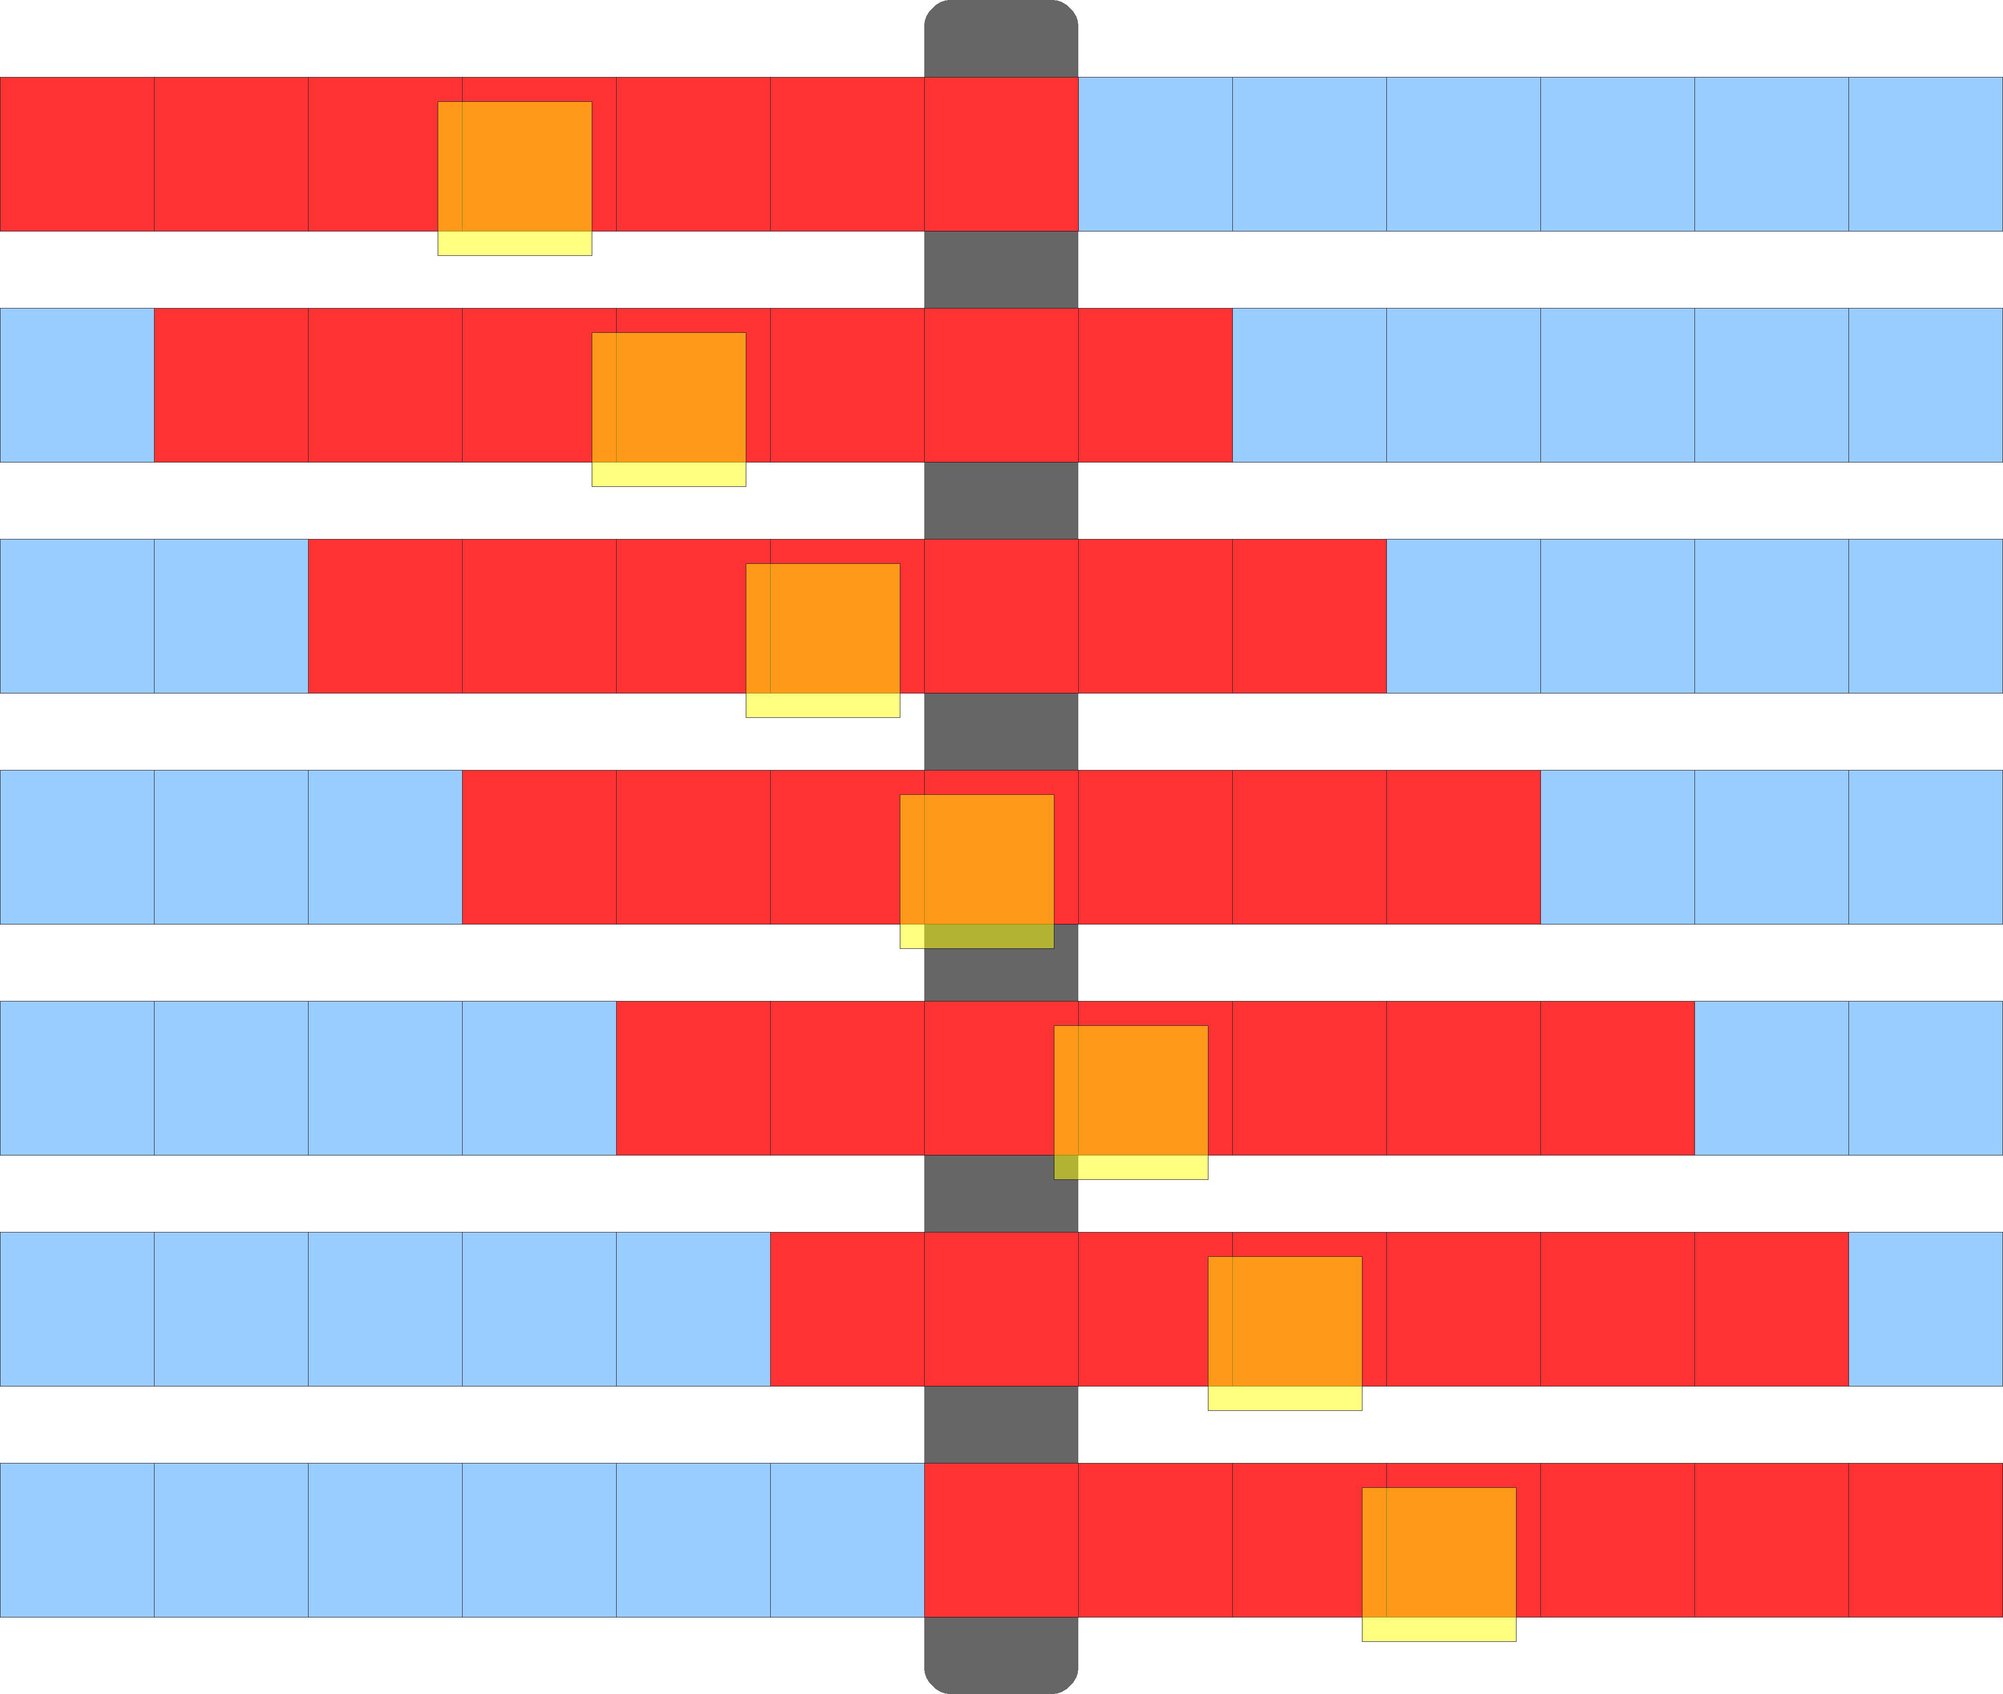
Implementing Within a Block
●
Each thread processes one output element
blockDim.x
elements per block
Input elements are read several times
–
●
– With radius 3, each input element is read seven times
With radius R, each input element is read (2R+1) times
–
CUDA Programming
53

Slide 53
Sharing Data Between Threads
Global memory accesses are likely to cause a bottleneck due to the limited memory bandwidth
Within a block, threads can share data via shared memory
●
●
–
–
Extremely fast on-chip memory, user-managed Think of it as a user-managed local cache
●
Declare using shared , allocated per thread- block
Data is not visible to threads in other blocks
●
CUDA Programming
54
© NVIDIA corp.

Slide 54
CUDA memory model
Thread Block
Thread Block
Shared Memory
Shared Memory
Registers
Registers
Registers
Registers
Thread
Thread
Thread
Thread
Local Memory
Local Memory
Local Memory
Local Memory
Global Memory
Constant Memory
Texture Memory
55
CUDA Programming

Slide 55
Implementing with shared memory
●
Cache data in shared memory
– Read (blockDim.x + 2 ´ radius) input elements from global memory to shared memory
Compute blockDim.x output elements
Write blockDim.x output elements to global memory
Each block needs a halo of radius elements at each boundary
–
–
–
in[]
halo on the left
halo on the right
out[]
blockDim.x output elements
CUDA Programming
56
© NVIDIA corp.

Slide 56
Implementing with shared memory
●
Let us make a few simplifying assumptions
–
–
The array length is a multiple of the thread block size The input (and output) array already includes an halo of
2*RADIUS elements
The halo is ignored for the output array
●
Idea
– Each thread block keeps a local cache of
blockDim.x + 2*RADIUS elements
Each thread copies one element from the global array to the local cache
The first RADIUS threads also take care of of filling the halo
–
–
CUDA Programming
57

Slide 57

Implementing with shared memory
blockDim.x blockDim.x blockDim.x blockDim.x
0
in[]
RADIUS
gindex lindex
RADIUS
0
temp[]
0 | 1 | 2 | 3 | 4 | 5 | 6 | 7
ThreadIdx.x
shared int temp[BLKDIM + 2 * RADIUS];
const int gindex = threadIdx.x + blockIdx.x * blockDim.x + RADIUS;
const int lindex = threadIdx.x + RADIUS;
/* … */
temp[lindex] = in[gindex];
if (threadIdx.x < RADIUS) {
temp[lindex - RADIUS] = in[gindex - RADIUS]; temp[lindex + BLOCK_SIZE] = in[gindex + BLOCK_SIZE];
CUDA Programming
58
}

Slide 58
Implementing with shared memory
blockDim.x blockDim.x blockDim.x blockDim.x
in[]
temp[]
0 | 1 | 2 | 3 | 4 | 5 | 6 | 7
ThreadIdx.x
shared int temp[BLKDIM + 2
const int gindex = threadIdx.x
const int lindex = threadIdx.x
/* … */
temp[lindex] = in[gindex]; if (threadIdx.x < RADIUS) {
*
+
+
RADIUS];
blockIdx.x * blockDim.x + RADIUS; RADIUS;
temp[lindex - RADIUS] = in[gindex - RADIUS];
temp[lindex + BLKDIM] = in[gindex + BLKDIM];
CUDA Programming
}

Slide 59
Implementing with shared memory
blockDim.x blockDim.x blockDim.x blockDim.x
in[]
temp[]
0 | 1 | 2 | 3 | 4 | 5 | 6 | 7
ThreadIdx.x
shared int temp[BLKDIM + 2
const int gindex = threadIdx.x
const int lindex = threadIdx.x
/* … */
temp[lindex] = in[gindex];
if (threadIdx.x < RADIUS) {
*
+
+
RADIUS];
blockIdx.x * blockDim.x + RADIUS; RADIUS;
temp[lindex - RADIUS] = in[gindex - RADIUS];
temp[lindex + BLKDIM] = in[gindex + BLKDIM];
CUDA Programming
}

Slide 60
Stencil kernel (does not work!)
global void stencil_1d(int *in, int *out) { shared int temp[BLKDIM + 2 * RADIUS]; | Wrong!
int gindex = threadIdx.x + blockIdx.x * blockDim.x + RADIUS; int lindex = threadIdx.x + RADIUS; int result = 0, offset; /* Read input elements into shared memory */ temp[lindex] = in[gindex]; if (threadIdx.x < RADIUS) { temp[lindex - RADIUS] = in[gindex - RADIUS]; temp[lindex + blockDim.x] = in[gindex + blockDim.x]; } /* Apply the stencil */ for (offset = -RADIUS ; offset <= RADIUS ; offset++) { result += temp[lindex + offset]; } /* Store the result */ out[gindex] = result; }
CUDA Programming 61
© NVIDIA corp.

Slide 61
The problem
All threads are not necessarily fully synchronized Suppose that thread (blockDim.x - 1) reads the halo before thread 0 has fetched it
– Data race!
●
●
in[]
temp[]
Warp
Warp
Warp
Thread Block
CUDA Programming
62
Note: CUDA warps actually contain 32 threads
© NVIDIA corp.

Slide 62
The solution: syncthreads()
Synchronizes all threads within a block
Used to prevent RAW / WAR / WAW hazards
All threads must reach the barrier
In conditional code, the condition must be uniform across the block
●
●
CUDA Programming
63
© NVIDIA corp.

Slide 63
Stencil kernel that works
global void stencil_1d(int *in, int *out) {
shared int temp[BLKDIM + 2 * RADIUS];
int gindex = threadIdx.x + blockIdx.x * blockDim.x + RADIUS;
int lindex = threadIdx.x + RADIUS;
int result = 0, offset;
/* Read input elements into shared memory */
temp[lindex] = in[gindex];
if (threadIdx.x < RADIUS) {
temp[lindex - RADIUS] = in[gindex - RADIUS]; temp[lindex + blockDim.x] = in[gindex + blockDim.x];
}
syncthreads();
/* Apply the stencil */
for (offset = -RADIUS ; offset <= RADIUS ; offset++) { result += temp[lindex + offset];
}
/* Store the result */
out[gindex] = result;
}
See cuda-stencil1d-shared.c
CUDA Programming 64
© NVIDIA corp.

Slide 64
Review
●
Use shared to declare a variable/array in
shared memory
–
–
Data is shared between threads in a block Not visible to threads in other blocks
Use syncthreads() as a barrier
– Use to prevent data hazards
●

Slide 65
Managing the device

Slide 66
Timing CUDA kernels
You can use the timing routines provided in hpc.h
However, since kernel invocations are asynchronous, you must call cudaDeviceSynchronize() to wait the kernel to complete execution
●
●
#include "hpc.h"
…
double tstart, tend;
printf("Elapsed time %f\n", tend – tstart);
tstart = hpc_gettime();
mykernel<<<X, Y>>>( ); /* kernel invocation */
cudaDeviceSynchronize(); /* wait for kernel to finish */
tend = hpc_gettime();

Slide 67
The device qualifier
●
The device
qualifier defines functions that
–
–
execute on the device
can be called from device code only
device functions are inlined, so they can return
●
a value
device float cuda_fmaxf(float a, float b)
{
return (a>b ? a : b);
}
global void my_kernel( float *v, int n )
{
int i = threadIdx.x + blockIdx.x * blockDim.x;
if (i<n) {
v[i] = cuda_fmaxf(1.0, v[i]);
}
}
CUDA Programming
68

Slide 68
The host qualifier
●
(Optional) denotes a function that
–
–
is executed on the host
can be called from host code only
default behavior when neither global nor
device are specified
–
●
You can use both the host and device
qualifiers for the same function
– The compiler produces two versions of the function: one for the GPU and one for the CPU
host device float my_fmaxf(float a, float b)
{
return (a>b ? a : b);
}
CUDA Programming
69

Slide 69
Recap function declaration
Executed on:
Only callable from:
Device
device
float deviceFunc()
Device
host
float hostFunc()
Host
Host
global
void kernelFunc()
Device
Host
CUDA Programming
70

Slide 70
The device qualifier
●
The device
qualifier can be applied to variables
–
–
–
easy way to statically allocate variables on the device can be applied to global variables only
cudaMemcpyToSymbol() / cudaMemcpyFromSymbol()
must be used to copy data from/to device variables
– will see an example in the lab
#define BLKDIM 1024
device float d_buf[BLKDIM];
int main( void )
{
float buf[BLKDIM];
…
dest
source
cudaMemcpyToSymbol(d_buf, buf, BLKDIM*sizeof(float));
…
cudaMemcpyFromSymbol(buf, d_buf, BLKDIM*sizeof(float));
}
CUDA Programming 71

Slide 71
The constant qualifier
●
Similar to device , denotes a (global) variable that is allocated in constant memory
The host must use cudaMemcpyToSymbol() to copy data from host memory to constant memory
– The device can not write to constant memory
See cuda-rotate.cu
●
●
CUDA Programming
72

Slide 72
Reporting Errors
●
All CUDA API calls return an error code (cudaError_t)
–
–
Error in the API call itself, OR
Error in an earlier asynchronous operation (e.g., kernel)
– cudaSuccess means no error
Get the error code for the last error:
cudaError_t cudaGetLastError(void)
Get a string to describe the error:
char *cudaGetErrorString(cudaError_t)
printf("%s\n", cudaGetErrorString(cudaGetLastError()));
●
●
CUDA Programming
73
© NVIDIA corp.

Slide 73
Reporting Errors
Some useful macros defined in hpc.h
– cudaSafeCall(Exp) execute Exp and checks for return status
●
Exp can be any CUDA function returning an error code, e.g., cudaMalloc, cudaMemcpy, …
cudaCheckError() checks error code from last CUDA operation
●
–
Usually, a kernel call
cudaCheckError() calls cudaDeviceSynchronize()
cudaSafeCall( cudaMemcpy(d_a, h_a, size, cudaMemcpyHostToDevice) ); my_kernel<<< 1, 1 >>>(d_a); cudaCheckError();
cudaSafeCall( cudaMemcpy(h_a, d_a, size, cudaMemcpyDeviceToHost) );
CUDA Programming
74

Slide 74
Device management
●
Application can query and select GPUs
– cudaGetDeviceCount(int *count) cudaSetDevice(int device) cudaGetDevice(int *device)
cudaGetDeviceProperties(cudaDeviceProp *prop, int device)
–
–
–
Multiple threads can share a device
A single thread can manage multiple devices
●
●
– cudaSetDevice(i) to select current device
cudaMemcpy(…) for peer-to-peer copies (requires OS and device support)
–
CUDA Programming
75
© NVIDIA corp.

Slide 75
Device management
●
On a multi-GPU installation, you can select the device to use with the CUDA_VISIBLE_DEVICES environment variable
CUDA_VISIBLE_DEVICES=0 ./cuda-stencil1d
select the first device
CUDA_VISIBLE_DEVICES=1 ./cuda-stencil1d
select the second device
●
●
CUDA Programming
76

Slide 76
Limits on the lab machine
Use the deviceQuery command
isi-raptor03 has three identical GPUs with the following features
●
●
CUDA capability
Global memory CUDA cores Warp size
Shared memory per block Constant memory
Max number of threads per block Max size of a thread block
Max grid size
6.1
8114 MB
1920
32
49152 B
65536 B
1024
(1024, 1024, 64)
(2147483647, 65535, 65535)
CUDA Program
ming
77

Slide 77
Limits on the lab machine
●
The compiler for the currently installed CUDA SDK version produces code for older GPU architectures
– with max grid size (65535, 65535)
If you need a grid with gridDim.x > 65535 you need to compile with
●
nvcc --gpu-architecture compute_30 program.cu -o program

Slide 78
Higher Block Dimensions

Slide 79
Matrix-Matrix multiply
●
Multiply two n ´ n matrices p and q
void matmul( float *p, float* q, float *r, int n)
{ int i, j, k; float v; for (i=0; i<n; i++) {
for (j=0; j<n; j++) { v = 0.0;
for (k=0; k<n; k++) {
v += p[i*n + k] * q[k*n + j];
}
r[i*n + j] = v;
}
}
}
j
q
r
i
p
CUDA Pr
ogramming
80

Slide 80
Matrix-Matrix multiply with thread blocks
●
Decompose the result matrix r into square blocks
Assign each block to a thread block
– All threads of the thread block compute one element of the result matrix
●
q
r
p
CUDA Pr
ogramming
81

Slide 81
Setting up the thread blocks
The dim3 data type can be used to define a one-, two-, or three-dimensional “size” for a thread or grid block
dim3 blk(3)
defines a variable “dim” representing a 3x1x1 block
dim3 blk(3, 4)
defines a variable “dim” representing a 3x4x1 block
– dim3 blk(3, 4, 7)
defines a variable “dim” representing a 3x4x7 block
●

Slide 82
Examples
●
Launch 3 blocks, 16 threads per block (1D)
mykernel<<<3, 16>>>( );
●
The same
dim3 grid(3);
dim3 block(16); mykernel<<<grid, block>>>( );
●
Launch (16 ´ 4) blocks, (8 ´ 8 ´ 8) threads per block
dim3 grid(16, 4); /* 2D */ dim3 block(8, 8, 8); /* 3D */ mykernel<<<grid, block>>>( );

Slide 83
Kernel invocation
●
Setup and kernel invocation
/* cuda-matmul.cu */
#define BLKDIM 32
int main( void )
{
…
dim3 block(BLKDIM, BLKDIM);
dim3 grid((N+BLKDIM-1)/BLKDIM, (N+BLKDIM-1)/BLKDIM);
…
/* Launch matmul() kernel on GPU */ matmul<<<grid, block>>>(d_p, d_q, d_r, N);
…
}

Slide 84
The matmul kernel
●
Each thread computes a single element r[i][j] of the result matrix r
const | int | i | = | blockIdx.y * blockDim.y | + | threadIdx.y;
const | int | j | = | blockIdx.x * blockDim.x | + | threadIdx.x;
blockIdx.x
threadIdx.x
j
threadIdx.y
i
blockDim.y
blockIdx.y
r
blockDim.x
CUDA Programming

Slide 85
The matmul kernel
●
The kernel function
global void matmul( float *p, float *q, float *r, int n )
{
const int i = blockIdx.y * blockDim.y + threadIdx.y; const int j = blockIdx.x * blockDim.x + threadIdx.x; int k;
float val = 0.0;
if ( i < n && j < n ) {
for (k=0; k<n; k++) {
val += p[i*n + k] * q[k*n + j];
}
r[i*n + j] = val;
}
}
CUDA Programming
86

Slide 86
Matrix-Matrix multiply
●
Multiply two n ´ n matrices p and q
void matmul( float *p, float* q, float *r, int n)
{ int i, j, k; float v; for (i=0; i<n; i++) {
for (j=0; j<n; j++) { v = 0.0;
for (k=0; k<n; k++) {
v += p[i*n + k] * q[k*n + j];
}
r[i*n + j] = v;
}
}
}
j
q
How many times are the elements of matrix p accessed?
r
i
How many times are the elements of matrix q accessed?
CUDA Pr
p
ogramming
87

Slide 87
Reducing the memory pressure
●
To reduce the number of read operations to global memory, we use
shared memory to cache the data
needed by each block to compute its portion of the result
This requires (2 ´ BLKDIM ´ n) elements, which might exceed the amount of shared memory allowed by
q
●
the device
p
r
CUDA Progra
mming
88

Slide 88
Reducing the memory pressure
●
The solution: divide the (BLKDIM ´ n) stripes of p and q into square blocks of (BLKDIM ´ BLKDIM) elements each
Operate on two blocks (for p and q) at a time
Q1 | q
Q2
Q3
●
R = P1⨉Q1 + P2⨉Q2 + P3⨉Q3
P1 | P2 | P3
p a
R
r
CUDA Progr
mming
89

Slide 89
How the new kernel works
●
For each m:
m
local_p
local_q
q
m
p
r

Slide 90
How the new kernel works
For each m:
– Copy blocks from p and q into shared memory local_p and local_q
●
m
local_p
local_q
q
m
p
r

Slide 91
How the new kernel works
●
For each m:
m
– Copy blocks from p and q into shared memory local_p and local_q in parallel
compute the matrix product local_p ´ local_q in parallel
local_p
local_q
q
–
m
p
r

Slide 92
How the new kernel works
●
For each m:
– Copy blocks from p and q into shared memory local_p and local_q in parallel
compute the matrix product local_p ´ local_q in parallel
m ← m + BLKDIM
local_p
local_q
m
q
–
m
–
p
r

Slide 93
How the new kernel works
●
For each m:
– Copy blocks from p and q into shared memory local_p and local_q in parallel
compute the matrix product local_p ´ local_q in parallel
m ← m + BLKDIM
local_p
local_q
m
q
–
m
–
p
r

Slide 94
How the new kernel works
●
For each m:
– Copy blocks from p and q into shared memory local_p and local_q in parallel
compute the matrix product local_p ´ local_q in parallel
m ← m + BLKDIM
local_p
local_q
m
q
–
m
–
p
r

Slide 95
How the new kernel works
●
For each m:
– Copy blocks from p and q into shared memory local_p and local_q in parallel
compute the matrix product local_p ´ local_q in parallel
m ← m + BLKDIM
local_p
local_q
q
m
–
m
–
p
r

Slide 96
How the new kernel works
●
For each m:
– Copy blocks from p and q into shared memory local_p and local_q in parallel
compute the matrix product local_p ´ local_q in parallel
m ← m + BLKDIM
local_p
local_q
q
m
–
m
–
p
r

Slide 97
How the new kernel works
●
For each m:
– Copy blocks from p and q into shared memory local_p and local_q in parallel
compute the matrix product local_p ´ local_q in parallel
m ← m + BLKDIM
local_p
local_q
q
m
–
m
–
p
r

Slide 98
The new matmul kernel
global void matmulb( float *p, float *q, float *r, int n )
{
shared float local_p[BLKDIM][BLKDIM];
shared float local_q[BLKDIM][BLKDIM];
const int bx = blockIdx.x; const int by = blockIdx.y; const int tx = threadIdx.x; const int ty = threadIdx.y; const int i = by * BLKDIM + ty;
const int j = bx * BLKDIM + tx;
float v = 0.0; int m, k;
for (m = 0; m < n; m += BLKDIM) { local_p[ty][tx] = p[i*n + (m + tx)]; local_q[ty][tx] = q[(m + ty)*n + j];
syncthreads();
for (k = 0; k < BLKDIM; k++) {
v += local_p[ty][k] * local_q[k][tx];
}
syncthreads();
}
r[i*n + j] = v;
Wait for all threads in the block to complete before starting the next iteration (overwriting local_p and local_q)
}
CUDA Programming
99
Credits: Salvatore Orlando

Slide 99
The new matmul kernel
The setup and kernel invocation remain the same See cuda-matmul.cu
●
●
99

Slide 100
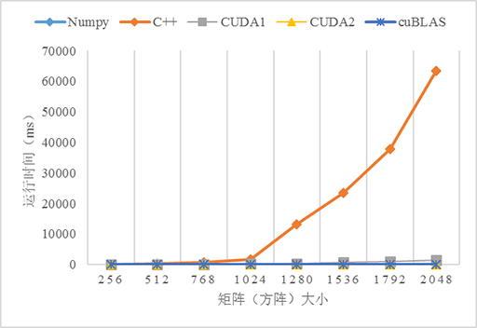
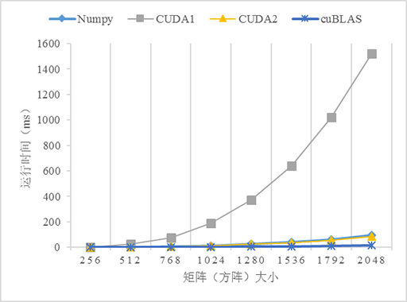
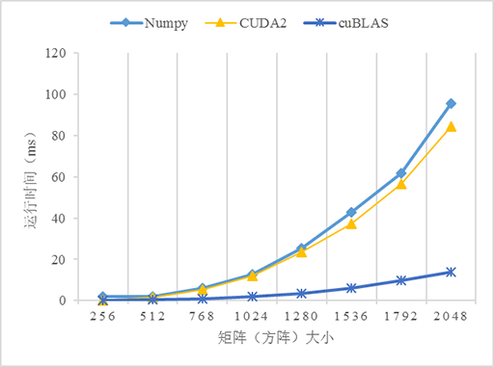
cuBLAS > GPU > Numpy

Slide 101
Reduction on the GPU
101

Slide 102
Problem statement
●
Given a nonempty array of floats or ints, compute the sum of all elements of the array
Basic idea
●
–
–
–
Decompose the problem across thread blocks Each thread block computes a partial reduction The CPU completes the reduction
102

Slide 103
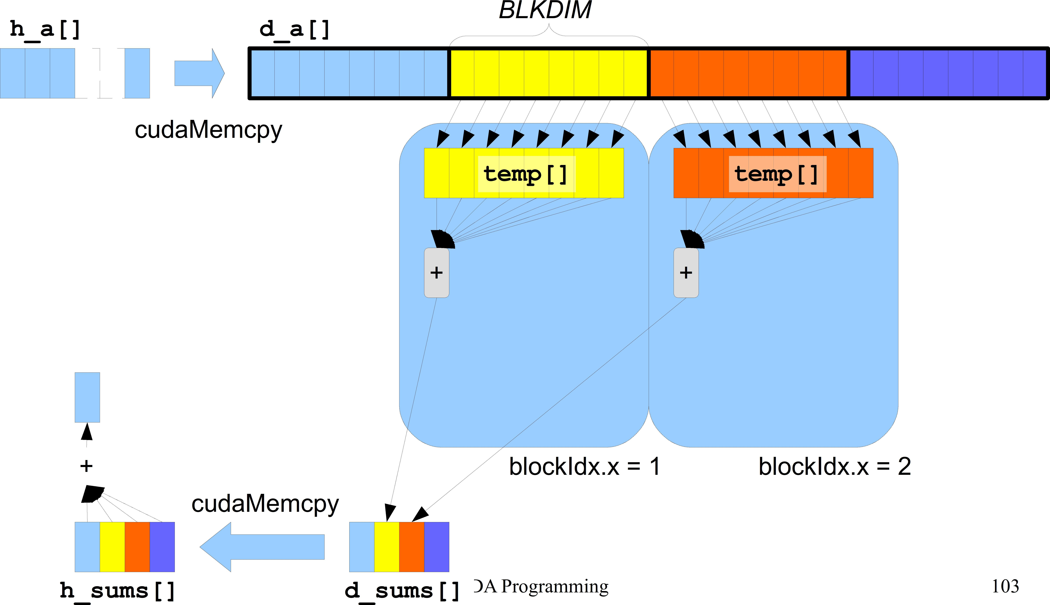
Solution #0 (naive)
Thread 0 of each block computes the local sum
●

Slide 104
Solution #0 kernel
#define BLKDIM 512
#define N_OF_BLOCKS 1024
#define N ((N_OF_BLOCKS)*(BLKDIM))
device int d_sums[N_OF_BLOCKS];
int h_sums[N_OF_BLOCKS];
Shared memory is not useful here; it will be
global void sum( int *a, int n )
{
shared int temp[BLKDIM]; int lindex = threadIdx.x; int bindex = blockIdx.x;
useful in the other
versions of this kernel
int gindex = threadIdx.x + blockIdx.x * blockDim.x; temp[lindex] = a[gindex];
syncthreads();
if ( 0 == lindex ) {
int i, my_sum = 0;
for (i=0; i<blockDim.x; i++) { my_sum += temp[i];
}
d_sums[bindex] = my_sum;
}
}
CUDA Programming
104
See cuda-reduction0.cu

Slide 105
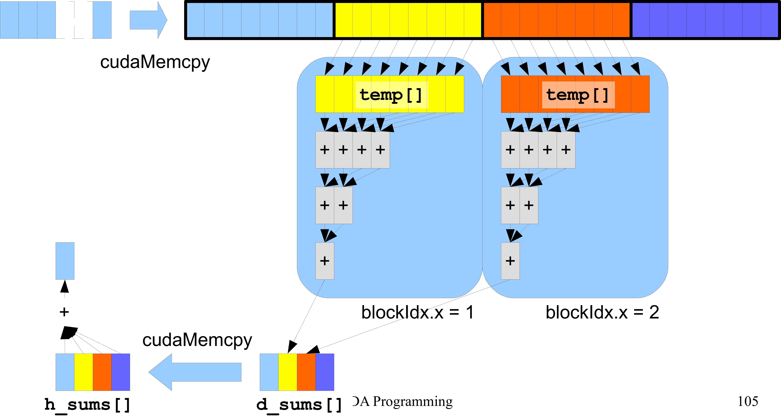
Solution #1 (better)
●
All threads within each block cooperate to compute the local sum
h_a[] d_a[]

Slide 106
Solution #1 kernel
This kernel only works if
global void sum( int *a, int n )
{
shared int temp[BLKDIM]; const int lindex = threadIdx.x; const int bindex = blockIdx.x;
●
●
BLKDIM is a power of two;
n is a multiple of BLKDIM
const int gindex = threadIdx.x + blockIdx.x * blockDim.x;
int bsize = blockDim.x / 2; temp[lindex] = a[gindex];
syncthreads(); while ( bsize > 0 ) {
if ( lindex < bsize ) {
temp[lindex] += temp[lindex + bsize];
}
bsize = bsize / 2;
syncthreads();
}
if ( 0 == lindex ) { d_sums[bindex] = temp[0];
}
}
See cuda-reduction1.cu
CUDA Programming 106

Slide 107
Atomic operations with CUDA
107

Slide 108
Atomic functions
●
Perform read-modify-write operations on one 32- or 64-bit word in global or shared memory
The operation is guaranteed to be atomic Example:
●
●
– Each thread adds 3 to the content of the memory location a a must point to a valid address in global or shared memory
–
global void my_kernel( int *a )
{
atomicAdd(a, 3);
}
108

Slide 109
Atomic functions
●
Many atomic functions are polymorphic
i.e., they work for items of different types
atomicAdd() works for items of type int, unsigned int, float, double, and others
Not all functions support the same types Check the documentation:
●
●
https://docs.nvidia.com/cuda/cuda-c-programming-gui de/index.html#atomic-functions
109

Slide 110
Atomic functions
int atomicAdd(int* addr, int val);
int old = *addr; *addr += val; return old;
int atomicSub(int* addr, int val);
int old = *addr; *addr -= val; return old;
int atomicExch(int* addr, int val);
int old = *addr; *addr = val; return old;
int atomicMin(int* addr, int val);
int old = *addr; *addr = min(*addr, val); return old
int atomicMax(int* addr, int val);
int old = *addr; *addr = max(*addr, val); return old
int atomicCAS(int* addr, int cmp, int val);
int old = *addr; *addr = (old == cmp ? val : old); return old;
...and others
●
●
●
●
●
●
●

Slide 111
Reduction with atomic operations
global void sum( int *a, int n, int *result )
{
shared int temp[BLKDIM];
int lindex = threadIdx.x;
int gindex = threadIdx.x + blockIdx.x * blockDim.x;
int bsize = blockDim.x / 2; temp[lindex] = a[gindex];
syncthreads();
while ( bsize > 0 ) {
if ( lindex < bsize ) {
This kernel works if
●
●
●
BLKDIM is a power of two;
n is a multiple of BLKDIM
*result is initially ZERO
temp[lindex] += temp[lindex + bsize];
}
bsize = bsize / 2;
syncthreads();
}
if ( 0 == lindex ) { atomicAdd(result, temp[0]);
}
}
See cuda-reduction3.cu
111

Slide 112
Memory Access Optimization Techniques for GPUs
112

Slide 113
CUDA memory model
Thread Block
Thread Block
Shared Memory
Shared Memory
Registers
Registers
Registers
Registers
Thread
Thread
Thread
Thread
Local Memory
Local Memory
Local Memory
Local Memory
Global Memory
Constant Memory
Texture Memory
113
CUDA Programming

Slide 114
Memory access patterns
So, if a thread just needs a single float (4B), this results in 32B or 128B being moved
The GPU can pack together (coalesce) memory accesses when consecutive threads access consecutive memory addresses
●
Each memory access moves 32 or 128 consecutive bytes
–
●
– Examples follow
CUDA Programming
114

Slide 115
Caching load
Warp requests 32 aligned, consecutive 4-byte words Addresses fall within 1 cache-line
●
●
–
–
–
–
Warp needs 128 bytes
128 bytes move across the bus on a miss Bus utilization: 100%
Transactions: 1
Addresses from a warp
Memory addresses
Slide credits: Justin Luitjens, NVIDIA Corporation

Slide 116
Caching load
Warp requests 32 aligned, permuted 4-byte words Addresses fall within 1 cache-line
●
●
–
–
–
–
Warp needs 128 bytes
128 bytes move across the bus on a miss Bus utilization: 100%
Transactions: 1
Addresses from a warp
Memory addresses
Slide credits: Justin Luitjens, NVIDIA Corporation

Slide 117
Caching load
●
Warp requests 32 misaligned, consecutive 4-byte words
Addresses fall within 2 cache-lines
●
–
–
–
–
Warp needs 128 bytes
256 bytes move across the bus on misses Bus utilization: 50%
Transactions: 2
Addresses from a warp
Memory addresses
Slide credits: Justin Luitjens, NVIDIA Corporation

Slide 118
Caching load
All threads in a warp request the same 4-byte word Addresses fall within a single cache-line
●
●
–
–
–
Warp needs 4 bytes
128 bytes move across the bus on a miss Bus utilization: 3.125%
Addresses from a warp
Memory addresses
Slide credits: Justin Luitjens, NVIDIA Corporation

Slide 119
Caching load
Warp requests 32 scattered 4-byte words Addresses fall within N cache-lines
●
●
–
–
–
Warp needs 128 bytes
N ´ 128 bytes move across the bus on a miss Bus utilization: 128 / (N ´ 128)
Addresses from a warp
Memory addresses
Slide credits: Justin Luitjens, NVIDIA Corporation

Slide 120
Example
See cuda-image-rotation.cu
Device memory
A B C
D E F
G H I
●
Device memory
G
D
A
H
E
B
I
F
C
120

Slide 121
Example
See cuda-image-rotation.cu
Device memory Shared memory
●
 | B | C
A
D | E | F
G | H | I
A
121

Slide 122
Example
See cuda-image-rotation.cu
Device memory Shared memory
●
Device memory
A | B | C
D | E | F
G | H | I
G
D
A
A
H
E
B
I
F
C
122

Slide 123
Example
typedef struct { float x; float y; float z;
} point3d;
global void
compute( point3d *points, int n )
{
int i = threadIdx.x; float x = points[i].x; float y = points[i].y; float z = points[i].z;
/* use x, y, z … */
}
●
Array of Structures (AoS) containing three floats
Think x, y, z as coordinates of a set of points
Each memory transaction read data that is not used
–
●
– Low efficiency
Addresses from a warp
x | y | z | x | y | z | x | y | z | x | y | z | x | y | z | x | y | z | x | y | z | x | y | z
points[0]
123

Slide 124
Example
typedef struct { float x; float y; float z;
} point3d;
global void
compute( point3d *points, int n )
{
int i = threadIdx.x; float x = points[i].x; float y = points[i].y; float z = points[i].z;
/* use x, y, z … */
}
●
Array of Structures (AoS) containing three floats
Think x, y, z as coordinates of a set of points
Each memory transaction read data that is not used
–
●
– Low efficiency
Addresses from a warp
x | y | z | x | y | z | x | y | z | x | y | z | x | y | z | x | y | z | x | y | z | x | y | z
points[0]
124

Slide 125
Example
typedef struct { float x; float y; float z;
} point3d;
global void
compute( point3d *points, int n )
{
int i = threadIdx.x; float x = points[i].x; float y = points[i].y; float z = points[i].z;
/* use x, y, z … */
}
●
Array of Structures (AoS) containing three floats
Think x, y, z as coordinates of a set of points
Each memory transaction read data that is not used
–
●
– Low efficiency
Addresses from a warp
x | y | z | x | y | z | x | y | z | x | y | z | x | y | z | x | y | z | x | y | z | x | y | z
points[0]
125

Slide 126
Example
typedef struct { float *x; float *y; float *z;
} points3d;
global void
compute( points3d *points, int n )
{
int i = threadIdx.x; float x = points->x[i]; float y = points->y[i]; float z = points->z[i];
/* use x, y, z … */
}
●
Structure of Arrays (SoA) containing three arrays of floats
Memory accesses can now be coalesced
●
Addresses from a warp
x | x | x | x | x | x | x | x | y | y | y | y | y | y | y | y | z | z | z | z | z | z | z | z
points.x[]
126

Slide 127
Example
typedef struct { float *x; float *y; float *z;
} points3d;
global void
compute( points3d *points, int n )
{
int i = threadIdx.x; float x = points->x[i]; float y = points->y[i]; float z = points->z[i];
/* use x, y, z … */
}
●
Structure of Arrays (SoA) containing three arrays of floats
Memory accesses can now be coalesced
●
Addresses from a warp
x | x | x | x | x | x | x | x | y | y | y | y | y | y | y | y | z | z | z | z | z | z | z | z
points.x[]
127

Slide 128
Example
typedef struct { float *x; float *y; float *z;
} points3d;
global void
compute( points3d *points, int n )
{
int i = threadIdx.x; float x = points->x[i]; float y = points->y[i]; float z = points->z[i];
/* use x, y, z … */
}
●
Structure of Arrays (SoA) containing three arrays of floats
Memory accesses can now be coalesced
●
Addresses from a warp
x | x | x | x | x | x | x | x | y | y | y | y | y | y | y | y | z | z | z | z | z | z | z | z
points.x[]
128

Slide 129
GPU memory optimization guidelines
●
Try to coalesce memory accesses
–
–
–
Align starting address (may require padding)
A warp should access contiguous memory locations Restructure your data so that it is a Structure of Arrays (SoA)
Have enough concurrent accesses to saturate the bus
– Launch enough threads to maximize throughput
●
CUDA Programming
129
Slide credits: Justin Luitjens, NVIDIA Corporation

Slide 130
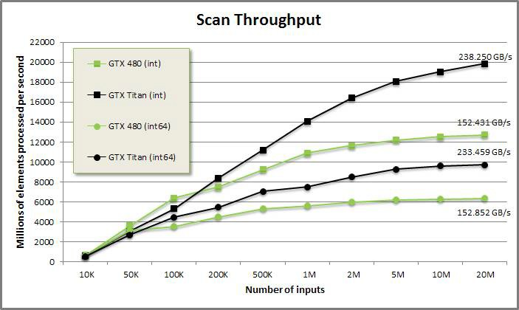
Performance Evaluation
●
We conventional concept of speedup can not be used
– The program has little or no control over the number of CUDA cores used
The hardware multiplexes CUDA threads to CUDA cores
–
●
We need different metrics, e.g.
– Throughput: number of processed data items/seconds as a function of the input size
Speedup vs CPU implementation
Source: https://moderngpu.github.io/scan.html
–
CUDA Programming
130

